Slide 1
C++ Course n°3 Templates & STL
By studio

Slide 2
Summary
What are templates ?
Template definition and instantiation
(Partial) specialization
Practise 1 : the Matrix class
STL : meet the containers
The standard algorithms
Iterators
Practise 2 : the Matrix class (again)
Auto
Lambdas
Constexpr
Optional, variant & any
Practise 3 : A simple parser

Slide 3
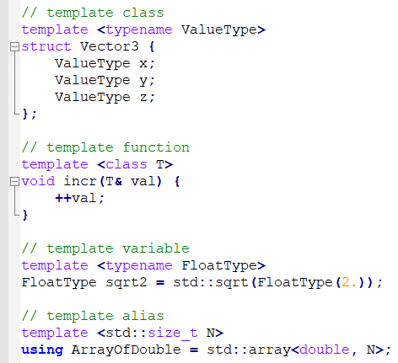
What are templates ?
Used to define families of C++ objects : functions, classes, variables, etc.
For example :

Slide 4
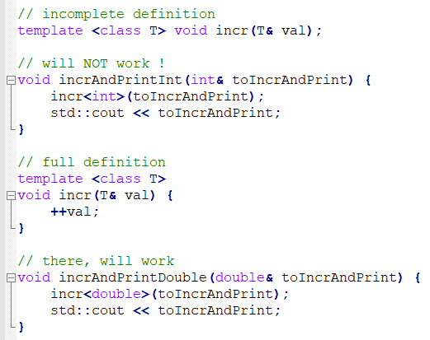
definition & Instantiation
Once a template is defined, so that you can use it, you have to instantiate it. Most of the times it is automatic !
Be careful though : since you define families of objects and not the objects themselves, the compiler has to see the full definition before you can use (instantiate) the template !

Slide 5
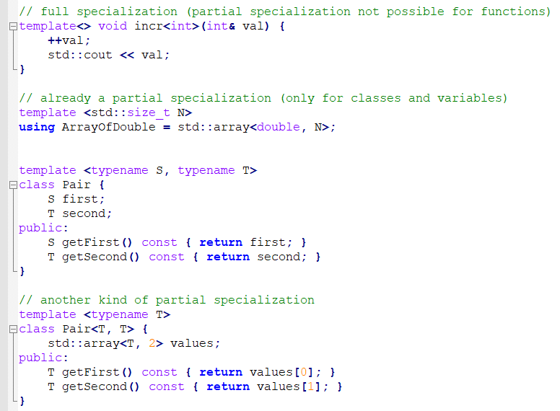
(Partial) specialization

Slide 6
Practise 1 : the Matrix class
Create a template class named Matrix, based on std::array, with templated dimensions, arithmetic operators and a specialization for bool values where addition and multiplication are replaced with logical operations OR and AND respectively.

Slide 7
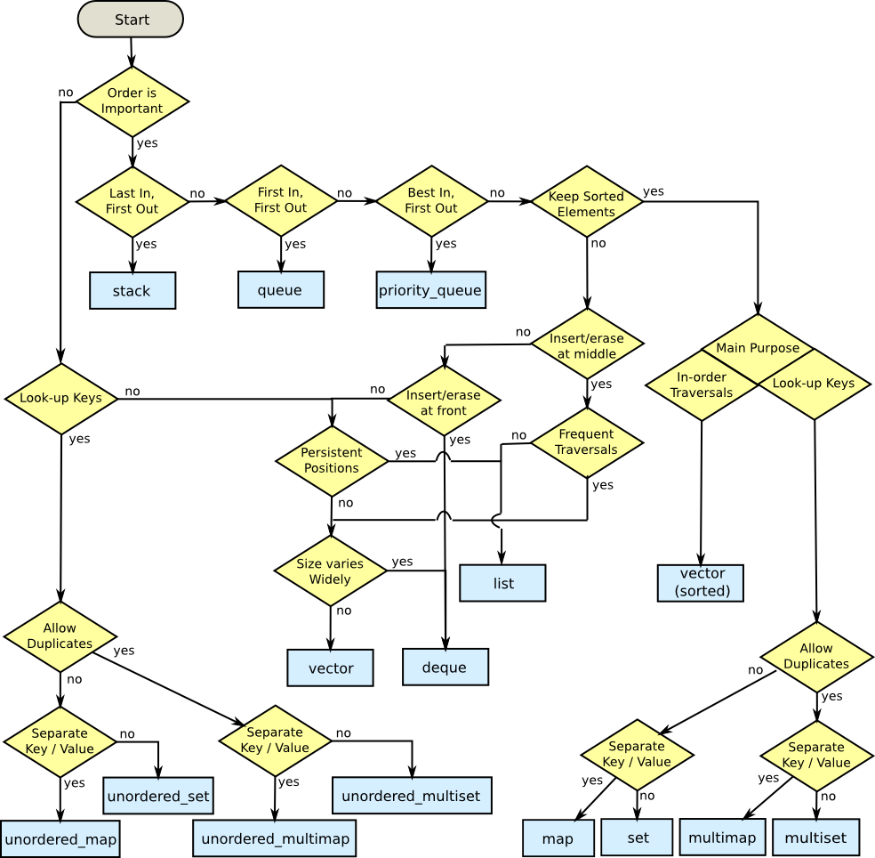
STL : Meet the containers
+ string & array
Most of the time, you’ll need either vector or map.

Slide 8
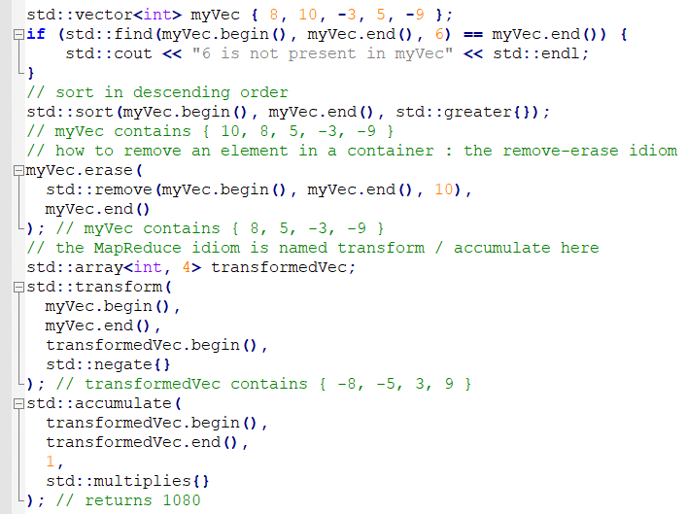
The standard algorithms
Included in <algorithm> and <numeric>, but sometimes you’ll also need <functional> and <iterator>

Slide 9
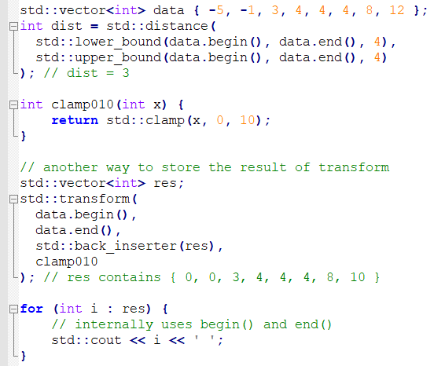
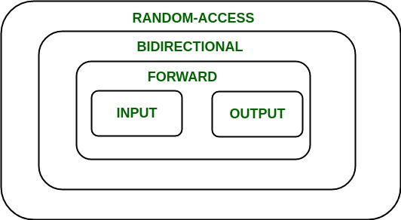
Iterators

Slide 10
Practise 2 : The matrix Reloaded®
Add functions to find the min and max element of the matrix, the sum and product of all elements of the matrix, the sum and product of two matrices, the transpose of the matrix, without using loops.
Bonus round : add methods that return iterators to the elements of the matrix in row-first and/or column-first order.

Slide 11
Functors & std::function
What are templates ?
Template definition and instantiation
Practise 1 : the Matrix class
STL : meet the containers
Iterators
The standard algorithms
Practise 2 : the Matrix class (again)
Functors & std::function
Lambdas
Decltype & auto
Practise 3 : A simple parser
Constexpr
Typename & using
SFINAE
The 3 monads (optional, variant & any)
Tuples & variadic templates
Practise 4 : Automatic lookup

Slide 12
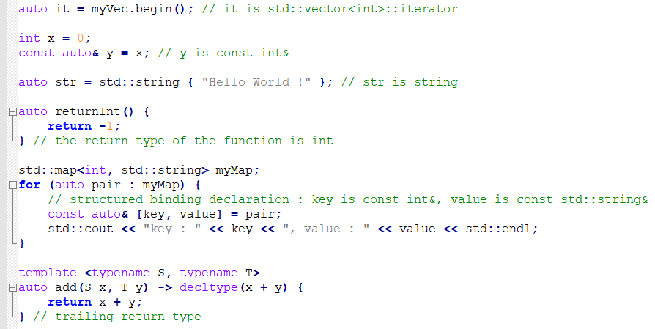
auto
Almost always auto !

Slide 13
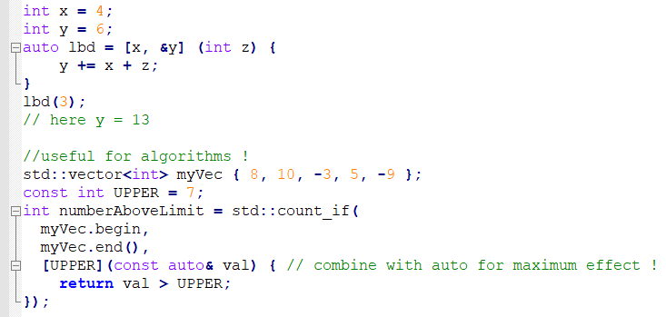
Lambdas

Slide 14
Constexpr
What are templates ?
Template definition and instantiation
Practise 1 : the Matrix class
STL : meet the containers
Iterators
The standard algorithms
Practise 2 : the Matrix class (again)
Functors & std::function
Lambdas
Auto
Practise 3 : A simple parser
Typename & using
Constexpr
SFINAE
The 3 monads (optional, variant & any)
Tuples & variadic templates
Practise 4 : Automatic lookup

Slide 15
The 3 monads
What are templates ?
Template definition and instantiation
Practise 1 : the Matrix class
STL : meet the containers
Iterators
The standard algorithms
Practise 2 : the Matrix class (again)
Functors & std::function
Lambdas
Auto
Practise 3 : A simple parser
Typename & using
Constexpr
SFINAE
The 3 monads (optional, variant & any)
Tuples & variadic templates
Practise 4 : Automatic lookup

Slide 16
Practise 3 : A simple parser
What are templates ?
Template definition and instantiation
Practise 1 : the Matrix class
STL : meet the containers
Iterators
The standard algorithms
Practise 2 : the Matrix class (again)
Functors & std::function
Lambdas
Auto
Practise 3 : A simple parser
Constexpr
Typename & using
SFINAE
The 3 monads (optional, variant & any)
Tuples & variadic templates
Practise 4 : Automatic lookup

